Slide 1
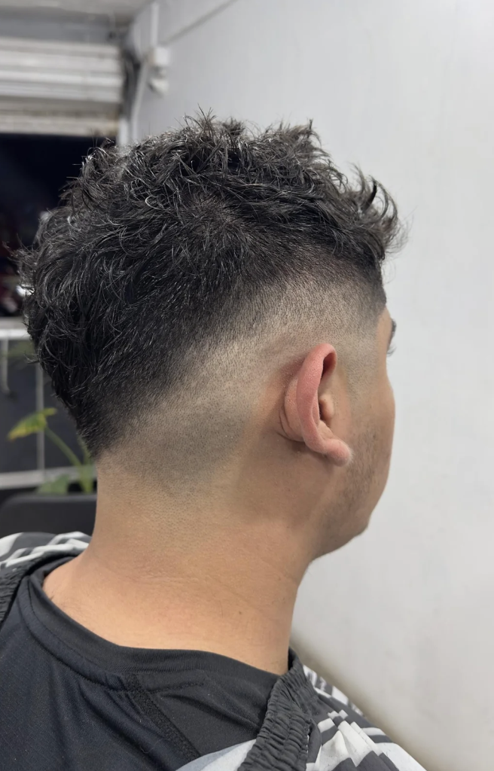
APPRENTICESHIP REVIEW
Ty Jackson
Seventeen-Month Checkpoint · December 12, 2026
Sharp Line Cuts · Prepared by James Gutierrez

Slide 2
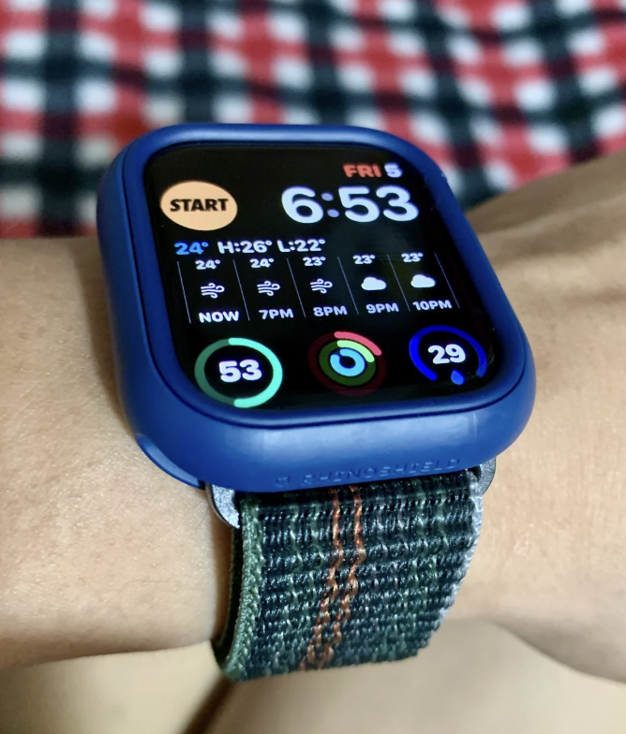
Snapshot
Where Ty stands at seventeen months
17 mo
In apprenticeship
21 yrs
Age
3 blks
From the shop
On track
Status
Jul 7, 2025
Start date
Dec 12, 2026
Checkpoint date
2027
Target: chair
McNichols
Target location
Ty joined from the neighborhood, three blocks away. Quiet, focused, learning fast. James is invested in his path to a licensed chair.

Slide 3
Skills Assessment
Score out of 10 | July 2025 baseline vs December 2026 current
Key Observations
● Fades improved 4 pts to an 8
● Lineups at 9 , near professional grade
● Hot-towel shave fastest growth area
● Sanitation reached a 10 , consistent
● Client flow at 8, shows confidence
● Beard work still developing, on pace

Slide 4
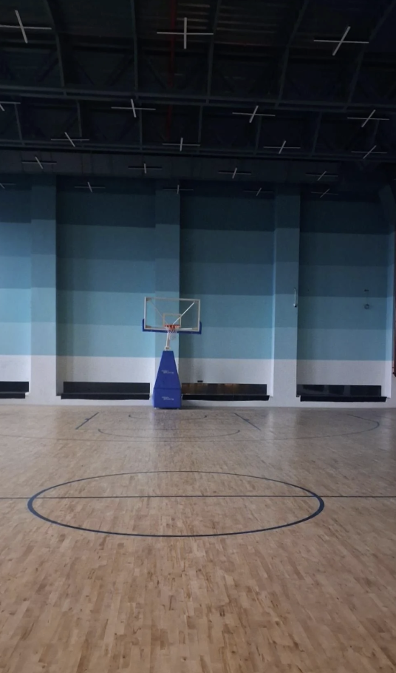
Path Forward
1
Michigan barber license exam
Target Q1 2027; review sessions starting January 2027.
2
Advanced fade curriculum
Weeks 18-24: skin-fade precision and natural hair textures.
3
Client chair introduction
Begin supervised client work January 2027 at the Livernois shop.
4
McNichols chair target
Licensed and ready for a chair at the March 27, 2027 soft opening.
5
Mentorship continuation
James's open-door policy stays in place through the transition.

